Slide 1
Merrilee Proffitt, OCLC Research @merrileeIam
MOOCs
& Libraries
An overview of the (current) landscape?

Slide 2
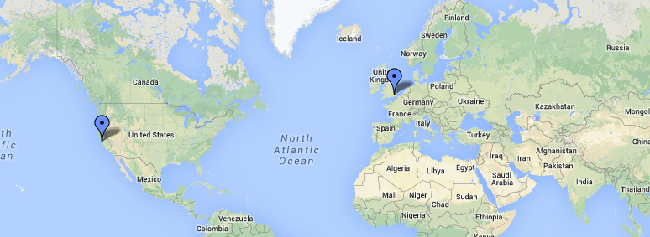
What you see depends upon where you sit

Slide 3


April 2012

Slide 4
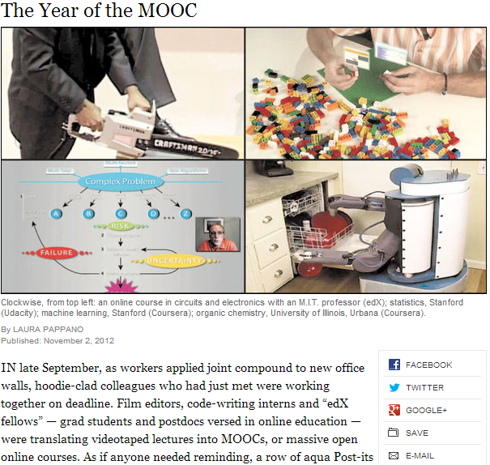
Notes:
And in the popular press. So much so that in November, the New York Times declared 2012 the year of the MOOC.
So why is this important? What’s all the fuss? There are many factors, but a primary attraction for institutions is the prospect of lowering the costs of higher education. As you are probably aware, the cost of college has been skyrocketing, and institutions are under fire to find a way to deliver a high quality education while reigning in costs. Online education may be one way of doing this.

Slide 5
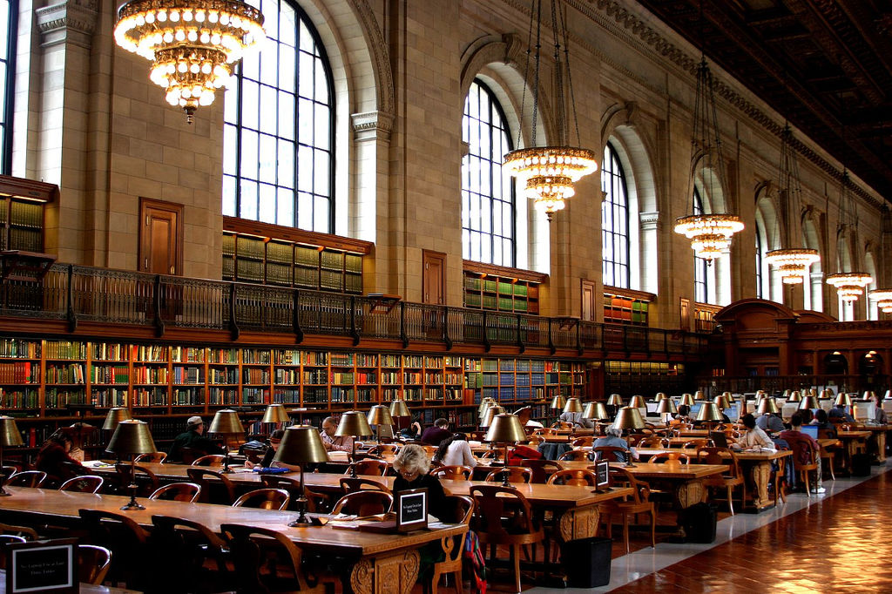
MOOCs?
www.flickr.com/photos/thomashawk/12241420
ccby-nc 2.0
Notes:
So with that personal preamble, what is the connection between MOOCs and libraries? What’s happening now and where are the opportunities? We set out to find out.

Slide 6
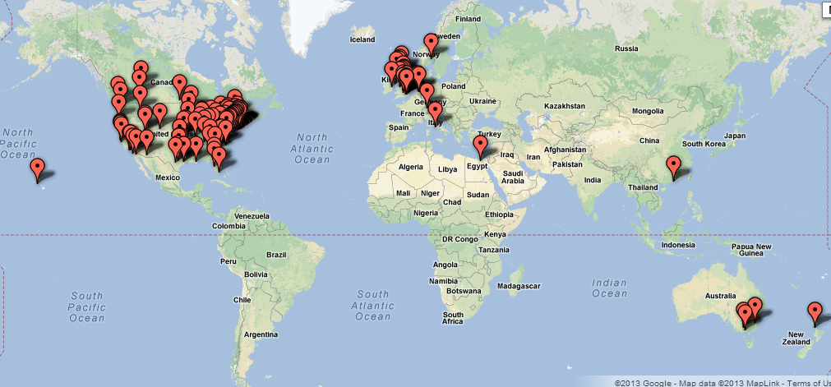
OCLC Research Library Partnership

Slide 7
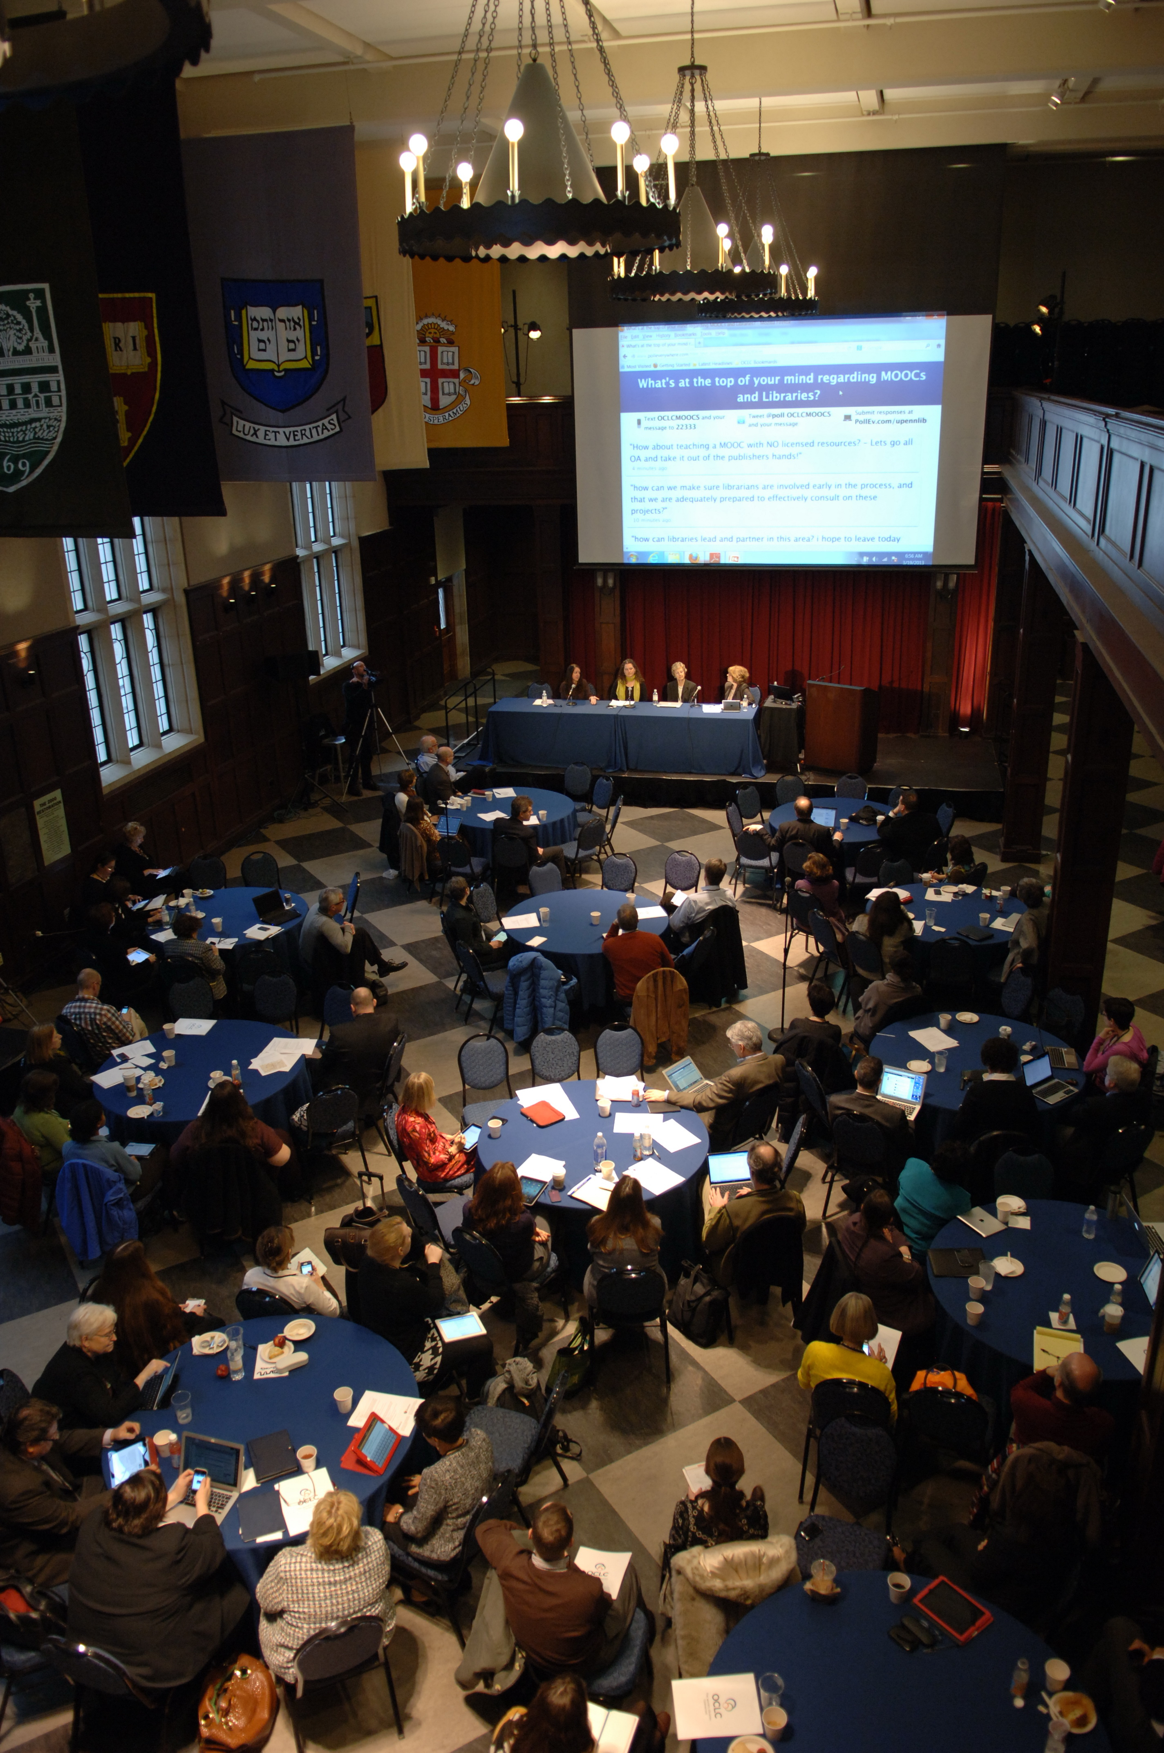
MOOCs and Libraries: Massive Opportunity or Overwhelming Challenge?
Themes:
Copyright
Production & Pedagogy
New roles for librarians
Audience
Summary on our blog HangingTogether.org

Slide 8
Emerging themes
Resources
Permissions / Licensing
[Fair use]
Linking
Ownership
Open Access
New opportunities for libraries

Slide 9
Outcomes
Get the library involved
Start talking/collaborating/sharing between libraries
Take MOOCs
Get in front of licensing and access
Create MOOCs
Support MOOC faculty
Support MOOC students
Create in-person support opportunities
Re-assess library assumptions and practices

Slide 10
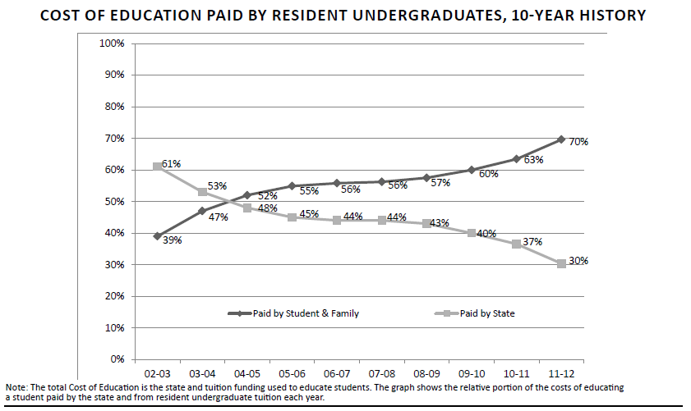
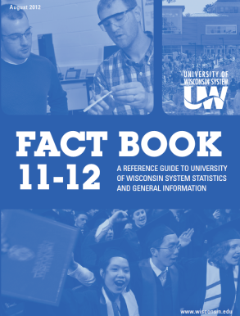

Slide 11
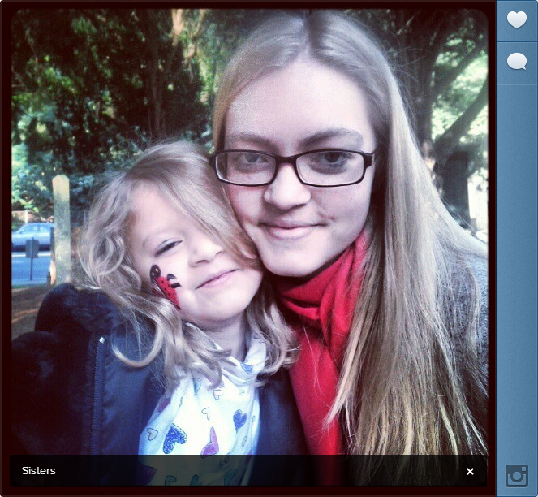
Notes:
But for me issues in higher ed, and particularly issues around rising tuitions costs is very personal. I’d like to share with you a tale of two girls, my oldest Anne, who is a freshman at NYU this year and my daughter Karydis, who just started Kindergarten. We are barely able to afford to send Anne to school (with scholarships and student loans) and I’m fearful about our prospects for our youngest. I was able to put myself through school by working part time in the library. The idea of doing this today is impossible. I will also say that looking at Anne’s residential experience as a humanties undergrad at NYU, it is not very different than mine in the 1980s. She emails her papers in and she registers for classes online – in a meeting last week someone observed the number of people in her classes have probably increased. But there’s not much about her residential college experience that’s very different than mine in the 1980s, which is almost shocking given how much other areas of life and work have changed substantially in that time.

Slide 12

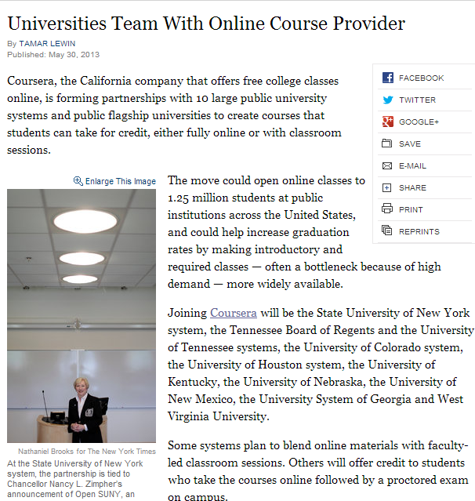

Slide 13
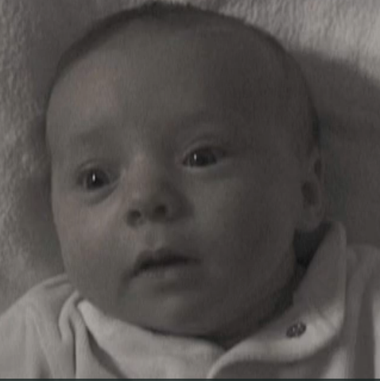
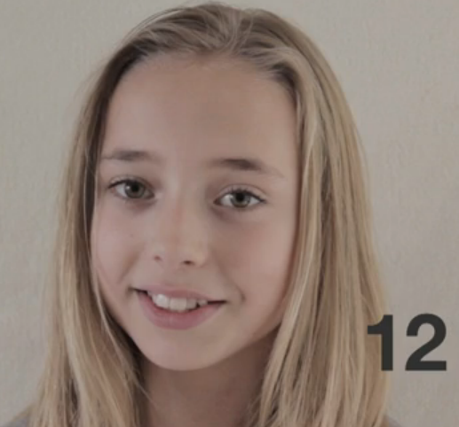
Can you see where this is going?
Lotte Time Lapse: Birth to 12 years in 2 min. 45.
http://vimeo.com/40448182

